Slide 1


Module 2
Introduction to Corda

Slide 2
Learning objectives
Understand that Corda has been designed to solve a specific business problem for regulated enterprises and this is reflected in its architecture
Understand how to think ”the Corda way”
Understand the key concepts which underpin how Corda
works

Slide 3
Agenda
The genesis of Corda
The Corda way of thinking
Corda key concepts
Recommended reading:
Corda Non-Technical Whitepaper
Corda Technical Whitepaper
The Corda Way of Thinking blogpost
https://docs.corda.net/key-concepts.html

Slide 4
Session 1
The genesis of Corda

Slide 5
The genesis of Corda
Why build Corda?
Design rationale

Slide 6

Why build Corda?

Slide 7
Mission objective
Requirements driven design
To establish the architecture for an open, enterprise-grade, shared platform for the immutable recording of financial events and execution of logic.

Slide 8
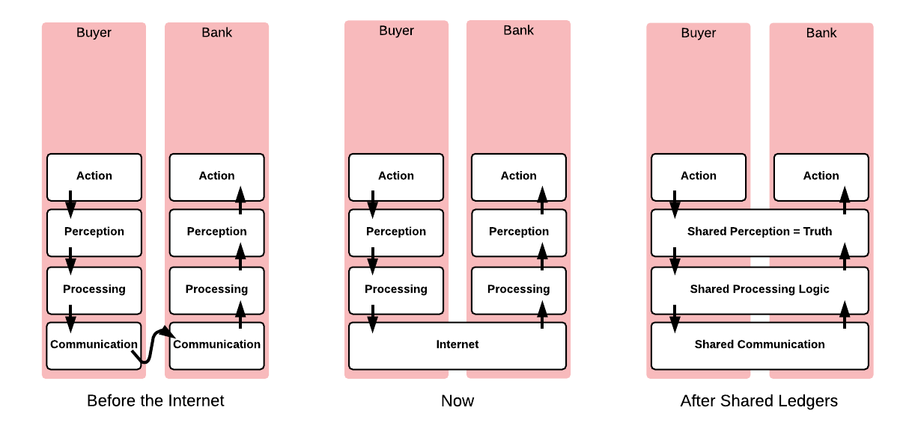


Back to basics
What problem are we trying to solve with distributed ledger technology?

Slide 9
Defining characteristics of distributed ledgers
Distributed ledgers are systems that enable parties who don’t fully trust each other to form and maintain consensus about the existence, status and evolution of a set of shared facts.
9

Slide 10
Introducing Corda
Corda is a distributed ledger platform designed and built from the ground up to record, manage and synchronise agreements (legal contracts), designed for use by regulated enterprises
p10.

Slide 11
Design rationale

Slide 12
Managing trade-offs
Designing the architecture of a distributed ledger platform is rooted in managing a set of trade-offs, primarily:
Privacy and confidentiality
Scalability
Security
Complexity
Among others…

Slide 13
You cannot have your cake and eat it!
Corda maintains the optimal balance of trade-offs for
  the domain it is intended to operate within, and;
  the business problems it is designed to solve
Meanwhile, Corda also provides flexibility for developers to tweak some of these trade-offs to suit their requirements
Example: pluggable consensus
There are no silver bullets!

Slide 14
Permissioned / Permissionless
Permissioned network
Permissionless networks are inappropriate for most scenarios involving
regulated enterprises

Slide 15
Transactions / Blocks
Chain of transactions
When considering permissioned networks, the use of multi transaction blocks
is not required to facilitate consensus

Slide 16
Peer-to-peer/Broadcast
Peer-to-peer
On the grounds of confidentiality, we reject the notion that data should be
broadcast to all participants or cumbersome pre-defined groups

Slide 17
Message queues / RPC
Message queues
Messaging queues tend to be more robust at the cost of complexity and
extra infrastructure

Slide 18
Reliance on existing judicial systems / “Code is law”
Legal Prose
A key requirement for the enterprise was the ability to rely on courts of law in
the case of conflicts

Slide 19
UTXO / Account model
UTXO Model
To maintain true immutability of the ledger, and make it possible to apply
transactions in parallel

Slide 20
Re-use/Build
Re-use
Wherever possible, we use industry standard bank friendly libraries and
technology instead of “reinventing the wheel”.

Slide 21
But Corda also offers flexibility
Pluggable consensus
Flexible transaction model
States can contain arbitrary information
Databases and message brokers

Slide 22
Summary
Corda is designed to solve a range of problems for regulated enterprises
Corda exists because other available platforms did not satisfy the stated mission objective
Building a DLT platform requires managing trade-offs
Corda is opinionated but also facilitates developer flexibility

Slide 23
Session 2
Key concepts

Slide 24
Key concepts
Corda Key Concepts
The Corda ledger
States
Transactions
Contracts
Legal prose
Commands
Timestamps
Attachments
Flows
Consensus
Notary services
Oracles
The Corda node and CorDapps
A Corda network

Slide 25
The Corda Ledger

Slide 26




A Corda network
A Corda network is a fully connected graph
No global broadcast or gossip network
Communication occurs on a peer to peer basis only
Peers communicate using AMQP/1.0 over TLS
Network map service publishes list of peers
Graph edges represent the potential to
communicate, not persistent connections
Think Email and SMTP
CORDA NODE

Slide 27
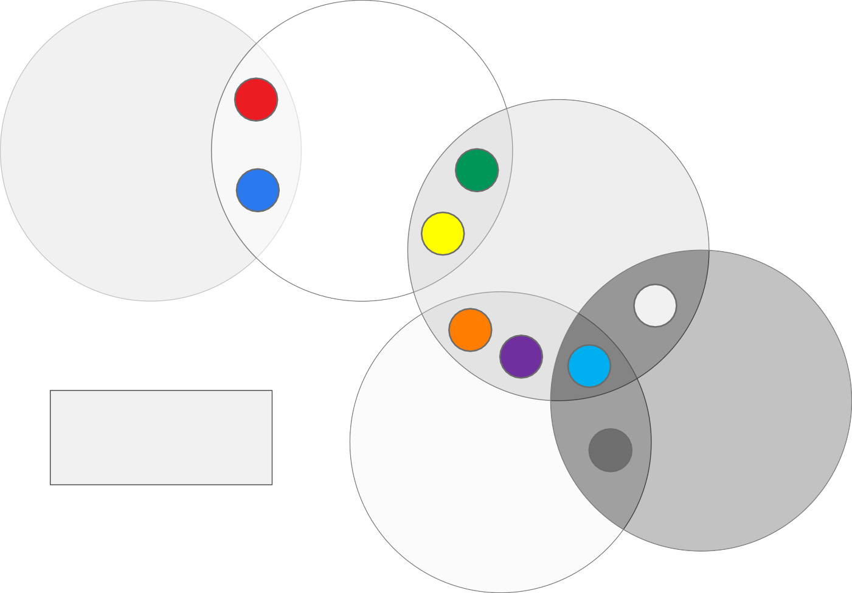
The Corda ledger
The ledger from
1
_{A}e_{L}a_{IC}c_{E}h₌p{ e₁er’s po}int of
ALICE
BOB
7
6
view is the union of
^{B}a^{O}l^{B}l in⁼t{ers¹ect⁷ions⁶wit⁵h }
7
5
CARL
2
other ne₉two₄rk p₆ee₅rs
9
CARL = {
2 3
}
4
3
DEMI
_{D}(_{E}so_{M}m_{I}e₌o{f w₂hich ₃may ₈be th}e empty set)
ED= { 9 4 8 3 }
Numbered circles represent unique shared facts
ED
8

Slide 28
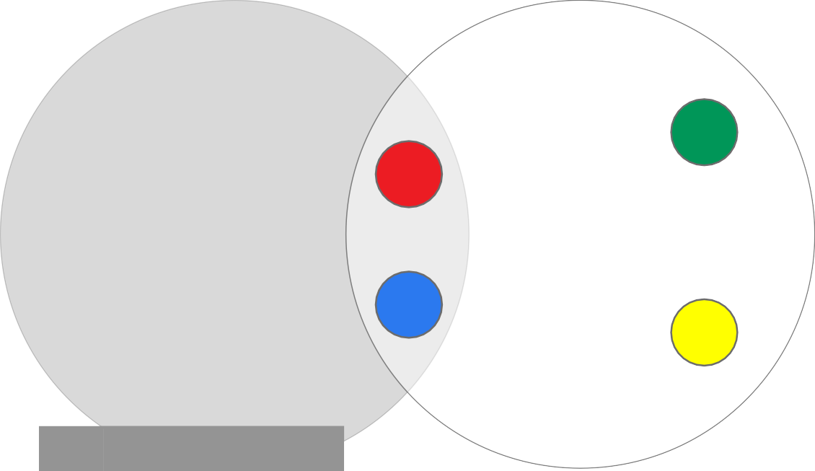
Anatomy of a bilateral ledger
There is no “central ledger”
Each network peer maintains a separate
vault of facts
Facts are like rows in a table
All peers to a shared fact store identical copies
Not all on-ledger facts have to be shared
with other peers
The black square “11” is an example of a on-ledger fact not shared with any peers
6
1
11
ALICE
BOB
7
5
Id | Fact
1 | “Much consensus”
7 | “So bilateral”
11 | “Wow ledger”
Id | Fact
1 | “Much consensus”
6 | “Very fact”
7 | “So bilateral”
5 | “amaze network”

Slide 29
The Corda ledger is subjective from each peer’s perspective

Slide 30
States

Slide 31
States represent (shared) facts
ALICE (IOUs)
BOB (IOUs)
Id | From | To | Amt | By | Penalty | Paid
1 | Alice | Bob | £10 | 2017-03-31 | 20% daily | £0
Id | From | To | Amt | By | Penalty | Paid
1 | Alice | Bob | £10 | 2017-03-31 | 20% daily | £0
Alice Owes Bob £10 Payable by 01/03/17
Late settlement incurs 20% daily interest on remaining balance

Slide 32
Alice pays Bob £5
Alice settles £5 of a £10 IOU with Bob so she creates a new
updated state to reflect this and marks the old one as historic
Alice Owes Bob £10 Payable by 2017-03-01
Late settlement incurs 20% daily interest on remaining balance
Alice Owes Bob £10 Payable by 2017-03-01
Late settlement incurs 20% daily interest on remaining balance
Alice paid £5

Slide 33
States can contain anything
In Corda, states don't just represent digital cash
The state model can be used to represent literally anything
States are statically typed – an IOU state is always an IOU state
Bonds, Syndicated Loans, CDOs, CLOs, Reference Data, Invoices, Letter of Credit, Pu Rate Swaps, Accounting Entries, Contract For Difference, Commercial Bank Credit, ntations, Collateral, KYC Data, Credit Default Swaps, Bids/Offers, Personal Informati

Slide 34
States are immutable objects that represent (shared) facts such as an agreement or contract at a specific point in time

Slide 35

State sequences
Alice Owes Bob £10
Payable by 2017-03-01
Late settlement incurs 20% daily interest on remaining balance
NO AGREEMENT
Alice Owes Bob £10
Payable by 2017-03-01
Late settlement incurs 20% daily interest on remaining balance
Alice paid £5
Alice borrows
£10 from Bob
Alice pays
Bob £5
2017-02-01
TIMELINE
2017-02-24

Slide 36

State sequences
Alice Owes Bob £10
Payable by 2017-03-01
Late settlement incurs 20% daily interest on remaining balance
Alice Owes Bob £10 Payable by 2017-03-01
Late settlement incurs 20% daily interest on remaining balance
Alice paid £5
AGREEMENT EXPIRED
Alice incurs interest of £1
Alice paid £5
Alice pays Bob £6 (£5 principal and
£1 interest)
interest is charged!
2017-03-02
TIMELINE
2017-03-02

Slide 37
The vault tracks state sequence heads
Counterparty
vaults
The vault tracks the heads of each state sequence
For states representing shared facts, each peer retains an identical copy
CONSUMED HISTORICAL STATES
UNCONSUMED
^{B}HEAD
B₀
B₁
^{B}HEAD
^{A}HEAD
VAULT
^{A}HEAD
A₀
A₁
A₂
A₃
^{C}HEAD
^{C}HEAD
S₀
S₁
S₂
^{S}HEAD
^{C}HEAD

Slide 38
The ledger from each peer’s point of view consists of all the state sequence heads (or non-historic states) tracked in the vault

Slide 39
Transactions

Slide 40
Transactions
We introduce transactions as atomic units of change to update the ledger
Transactions reference zero or more input states and create zero or more output states
The newly created output states replace the input states
which are marked as historic
INPUT
STATE
OUTPUT STATE

Slide 41




Transactions can be arbitrarily complex
Transactions may combine issuances, updates and exits.
D₄
D₅
A₀
A₁
C₀
C₀
C
1
A₂
A₁
B₀
B₀
A₂

Slide 42


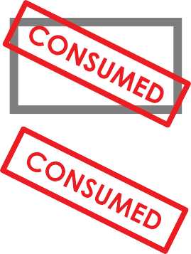


Transactions are atomic
A Transaction in Corda is an indivisible and irreducible set of changes such that either all occur, or nothing occurs.
C₀
C₀
C₀
C₀
A₁
A₂
A₁
A₂
B₁
B₁

Slide 43
Committing transactions
Example: Alice partially settles an IOU with Bob.
IOU₁
From: Alice To: Bob Amount: £10
IOU₂
From: Alice To: Bob Amount: £5
^{B}AAºsli^{b}cthe^{s}e^{ig}sitg^{n}ran^{s.}ns.saction is
Acus rtrheenttlryaunnsasigctnioend iist ^{n}iosºnul^{w}nycp^{fu}oa^{l}m^{l}r^{y}tima^{si}li^{g}ltyt^{n}es^{e}dig^{d}an^{b}ne^{y}d, ^{t}itth^{h}iu^{e}s ss^{r},t^{e}iall^{q}up^{u}n^{i}r^{r}oc^{e}po^{d}mo^{p}sma^{e}l^{e}ittt^{r}oe^{s} d. ªup^{nd}a^{c}tªe^{n}th^{b}e^{e}ledger
committed.
The transaction is
CASH₁
Owner: Alice Currency: GBP Amount: £5
CASH₂
Owner: Bob
Currency: GBP
Amount: £5
^{SIG}ALICE
SIG_{BOB}

Slide 44
Transactions are not instructions
Transactions are not instructions which require action
Instead, transaction creators calculate an updated ledger
which is reflected by the output states
The output states are the updated ledger!
In other words: Corda transactions state what the updates
are as opposed to how to calculate the updates

Slide 45
Transactions in summary
Any peer may create a transaction proposal
Transaction proposals are uncommitted by default
Before a transaction proposal is committed it must first be digitally signed and then verified by all required peers on a need-to-know basis
Once a transaction is committed it marks the input state references as historic and creates new output states reflecting an updated ledger

Slide 46
Contracts

Slide 47
Contracts
Corda mandates that each state inside a transaction must reference a contract
TRANSACTION STATE
CONTRACT
IOU STATE PROPERTIES
IOU CONTRACT CODE
REFERENCES
IOU CONTRACT REF
PARTICIPANTS
Alice
Bob
IOU LEGAL PROSE

Slide 48
Contracts
As transactions may contain multiple state types, multiple contracts can be referenced in a transaction
The Corda platform will use
all referenced contract code to verify a (proposed) transaction
CASH CONTRACT
REFERENCES
REFERENCES
VALIDATES
CASH₀
CASH₁
BOND₁
BOND₂
REFERENCES
VALIDATES
REFERENCES
BOND CONTRACT

Slide 49
Contract code
The verification function is defined in the contract code.
The function takes a transaction as a parameter and either throws an exception if the transaction fails verification, or returns nothing if the transaction verifies.
In Kotlin, Unit is a type with only one value: the Unit object. This type corresponds to the void type in Java/C.
fun verify(tx: Transaction): Unit

Slide 50
Contract code
// Transaction must have zero inputs. tx.inputs.size() == 0
// Transaction must have one output. tx.outputs.size() == 1
// The lender cannot be the borrower.
tx.outputs[0].lender != tx.outputs[0].borrower
// The output state must contain an amount > 0. tx.outputs[0].amount > 0

Slide 51
The contract code is a “pure” function executed in a deterministic environment, on a need-to-know basis which verifies transactions

Slide 52
Commands

Slide 53




States can evolve in multiple ways
IOU₁
From: Alice To: Bob Amount: £10
IOU₂
From: Alice To: Bob Amount: £5
IOU₂
From: Alice To: Bob Amount: £10
Defaulted: TRUE

Slide 54


Commands
INPUT STATES
COMMANDS
OUTPUT STATES
IOU₁
From: Alice To: Bob Amount: £10
IOU₂
From: Alice To: Bob Amount: £5
Alice settles £5 of a
£10 debt with Bob, so creates a transaction proposal
CASH₁
Owner: Alice
Amount: £5
CASH₂
Owner: Bob
Amount: £5
^{SIG}ALICE
SIG_{BOB}

Slide 55
Commands parameterise transactions hinting to their intent and specify the required signers via a list of public keys

Slide 56
Timestamps

Slide 57
Timestamps
Timestamp windows may be open ended in order to
Timestamps can
com uni_{a}c_{s}a_{se}te_{rt a}th_{t}a_{ra}t_{n}t_{sO}h_{ar}e_{cwti}t_{iot}r_{hnin}ns_{a}a_{s}c_{pe}ti_{c}o_{i}n_{fie}o_{d}ccurred before a certain
m
a
e
Before a
time or_{sp}a_{e}ft_{c}eh_{if}r_{i}a_{e}ap_{d}p_{t}ce_{im}en_{e}retdaianftetirma ti,mbeuwtinhdooww much before or after is unimportant. specified time
TIMELINE

Slide 58
Timestamps assert that a transaction happened within a specified time window

Slide 59
Attachments

Slide 60
Attachments
Transactions can also contain a number of attachments
Attachments are zip files and identified by hash
Attachments are referenced within a transaction, but not included in the transaction itself
Attachments are intended for data on the ledger that
multiple peers may wish to reuse over and over again
A transaction creator chooses which files to attach

Slide 61
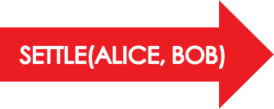
Attachments
IOU₁
From: Alice To: Bob Amount: £10
IOU₂
From: Alice To: Bob Amount: £5
Attachments are added by transaction creators and identified by hash within the transaction
CASH₁
Owner: Alice Currency: GBP Amount: £5
CASH₂
Owner: Bob Currency: GBP Amount: £5
TIMESTAMP
ATTACHMENTS
57g43ig…
3hefwl7n…
^{SIG}ALICE
SIG_{BOB}

Slide 62
Attachments
Attachments may contain:
Contract code and associated state definitions (.class files)
Legal prose template and parameters
Data files which support the contract code e.g. currency definitions, public holiday calendars or financial data

Slide 63
Attachments are zip files referenced in a transaction by hash but not included in the transaction itself

Slide 64


Creating a transaction proposal
INPUT STATES COMMANDS
OUTPUT STATES
435162. AIATAfhdredqtracinunaeoiprntewimmusdatlmye,csastcatatidroanetdndemasatpend arpoeutrfotetdaprceaohntslmaicssttleaiosntfenatpsohsuwabsrhliec.ady knfoerycsseigfsonsrainergyaachnd cveormifimcaatniodnsbpyeacilflying wrehqicuihrepdepeersenrseed to sign the transaction
IOU₀
From: Alice To: Bob Amount: £10
(TX HASH, ID)
REFERENCE
CASH₁
Owner: Alice
Amount: £10
CASH₂
Owner: Bob
Amount: £10
TIMESTAMP
ATTACHMENTS
4jg8493hgf…

Slide 65
Transactions summary
Transactions are an atomic set of changes
Transactions contain zero or more input and output states
States are grouped by type
Transactions contain one or more commands
Transactions can contain a timestamp
Transactions can contain zero or more attachments
Transactions are proposed and then subsequently signed and verified by the required peers

Slide 66
Flows

Slide 67



Alice and Bob agree upon an IOU
1. Alice creates a new
5. Alice verifies the
ALICE
transaction proposal
4. Bob sends back the transaction and his signature to Alice
transaction and checks
2a. nAdlicseigsnesnitds the
Bob’s signature
proposal and her signature to Bob
3. Bob inspects the proposal, verifies it and then signs it
BOB
Uninvolved peers do not receive
any of Alice’s or Bob’s transactions

Slide 68
You can write blocking code that never blocks!
Bob’s flow is check-pointed here
// Alice
tx = new Tx() peer = “Bob” sig = sign(tx)
// BOB
peer = “Alice”
Res = receive(peer) check(res.sigA) verify(res.tx) sigB = sign(res.tx)
When calling the network Alice’s fibre is suspended and serialised to disk (or check- pointed). If Alice’s node fails or restarts, she can deserialise the fibre and continue the flow when her node reboots
payload = (tx, sig)
res = sendAndReceive(payload, peer)
check(res.sigB) verify(res.tx) commit(res.tx)
Check-pointed
payload = (res.tx, sigB)
send(payload, peer) commit(res.tx)
… and here

Slide 69
The two party deal flow
This is the flow Alice and Bob use to agree upon an IOU, in Corda it can be called as a sub-flow.
INITIATOR (ALICE) | GET DATA FROM CREATE _{SIGN TX} INTERNAL TX SYSTEM | FLOW SUSPENDED AND CHECKPOINTED
INSPECT AND VERIFY TX
END
COMMIT TX
SEND(TX + SIG)
SEND(TX + SIG)
RESPONDER (BOB)
INSPECT AND VERIFY TX
SIGN TX
COMMIT TX
END

Slide 70
Flows are light-weight processes used to coordinate the complex multi-step, multi- peer interactions required for peers to reach consensus about shared facts

Slide 71
Consensus

Slide 72
Two types of consensus
Peers reach consensus over transactions in two ways:
Uniqueness consensus
Verification consensus

Slide 73

Uniqueness consensus
By now you have probably realised that without uniqueness consensus a nefarious actor can use the same cash input state reference in multiple transactions. How do we stop this?
C_{B}
PAY
C_{C}
BOB SENDS CASH
TO CHARLIE
ALICE ISSUES CASH TO BOB
SIG_{B}
C_{B}
ISSUE
SIG_{A}
C_{B}
PAY
C_{D}
BOB SENDS CASH TO DAN
SIG_{B}

Slide 74
Verification consensus
In Corda, verification consensus involves peers reaching certainty that a transaction:
is signed by all required peers listed in the commands
satisfies the constraints defined by the contracts pointed to
by the input and output states
However there is an additional step required…

Slide 75



Verification consensus
ALICE SWAPS A BOND WITH DAN FOR CASH
ALICE PAYS CASH TO BOB SETTLING THE £10 IOU
C_{D} C_{A}
PAY
Cash
Owner: Alice Amount: 10 Issuer: Charlie
Cash
Owner: Bob Amount: 10 Issuer: Charlie
B_{A}
SEND
B_{D}
PAY(A)
CHARLIE ISSUES
CASH TO DAN
SIG_{A} SIG_{D}
IOU
From: Alice To: Bob Amount: 10
Bob verifies the previous
SETTLE(A, B)
ISSUE
C_{D}
SIG_{C}
... And the one befotrraentshaactt.iTohnis is the
Alice presents Bob
issuance transaction and it was signed
with a transaction
by Charlie, so the Cash is a valid claim!

Slide 76
Notary services

Slide 77
Notary services track used states
In simple terms, notaries maintain a map keyed with input state references:
Key: (Transaction ID, Output Index)
Value: (Transaction ID, Input Index, Requesting Peer)
The map values indicate the ID of the transaction which used the state as an input and marked it as historic, as well as the identity of the requesting peer.

Slide 78
Notary services workflow
When a proposed transaction is sent to a notary service the notary checks if any of the input state references are already in the map and one of two things may happen:
If any are in the map, the notary throws an Exception and
notes that there is a conflict
If none are in the map then the notary adds each input state to the map and signs the proposed transaction

Slide 79
Notaries provide consensus for
transactions on a Corda Network

Slide 80
Oracles

Slide 81
Oracles
An oracle is a source of data or calculations, which has been accepted by multiple peers as authoritative,
binding and definitive for an agreed set of values or range of calculations
The oracle may source its data from external observations
or calculate its results based on inputs received from on- ledger states or attachments

Slide 82

Embedding external data in commands
CASH₁
Owner: Alice
Amount: £10
CASH₂
Owner: Bob
Amount: £10
CASH₁
Owner: Bob
Amount: $12
CASH₂
Owner: Alice
Amount: $12
^{SIG}ALICE
SIG_{BOB}
^{SIG}ORACLE

Slide 83

Embedding data in attachments
CASH₁
Owner: Alice
Amount: £10
CASH₂
Owner: Bob
Amount: £10
CASH₁
Owner: Bob
Amount: $12
CASH₂
Owner: Alice
Amount: $12
Static data required for transaction verification
ATTACHMENTS
4jg8493hgf…
^{SIG}ALICE
SIG_{BOB}
^{SIG}ORACLE

Slide 84
Oracles are an authority that attests to
(and may also provide) off-ledger facts needed to verify transaction proposals

Slide 85
The Corda Node

Slide 86
A Corda node
Contracts
State definition
Flows
Services
CorDapp
CorDapp
CorDapp
Client
RPC
Services Interface
Other peers
...
Messaging
Vault
Identity
Storage
Persistence

Slide 87
A Corda node implements a collection
of services required to participate in a Corda network

Slide 88
CorDapps

Slide 89
CorDapps
CorDapp
Contracts
States
Flows and Services

Slide 90
CorDapps are Corda node extentions which comprise the states, contracts and flows required to implement some specific business logic

Slide 91
A Corda Network

Slide 92



A Corda network
DISTRIBUTED NOTARY SERVICE
Name: Alice
Services: Cash Issuer, bond issuer
Address: 192.168.0.3:10005
Public key: 5h54h5wv632vhy55
NOTARY NODE
NODE
NODE
NETWORK MAP SERVICE DISTRIBUTING NETWORKMAP VIA HTTP
e.g. through Content Delivery Network (CDN)
NODE
PERMISSIONING SERVICE CERTIFICATE SIGNING
NODE
Name: Bob
Services: Cash Issuer, bond issuer
Address: 192.168.0.4:10005
Public key: 5hw03nnk43jknkj4n

Slide 93
A Corda network comprises:
A doorman
An external network map service
Two or more Corda nodes
Zero or more oracles
One or more notary services
p95.

Slide 94
Summary
Corda Key Concepts
The Corda ledger
States
Transactions
Contracts
Legal prose
Commands
Timestamps
Attachments
Flows
Consensus
Notary services
Oracles
The Corda node and CorDapps
A Corda network

